Slide 1
End of KS3 assessments
Projects: Project 2

Slide 2
Objectives
In this lesson, you will demonstrate:
your ability to use spreadsheet functions to build a finance system
an iterative approach to development
the importance of versioning.

Slide 3
The project
Over the next six weeks, you will be using your spreadsheet skills to develop a finance system for a small hotel.
The finance system contains a number of different features and you should use an iterative approach to project development to build and test each feature to make sure it is working as it should before moving on to add the next feature.
Save a new version of the spreadsheet each time you begin to add a new feature, so you can return to a working version if something goes wrong.

Slide 4
The finance system
As a starting point, you will be provided with a workbook containing two spreadsheets (also known as ‘tabs’).
One tab contains data about guests and one tab contains data about services and how much they cost.
Among the tasks you will need to complete to build the finance system, you will need to create an invoice and a summary of the hotel’s accounts.

Slide 5
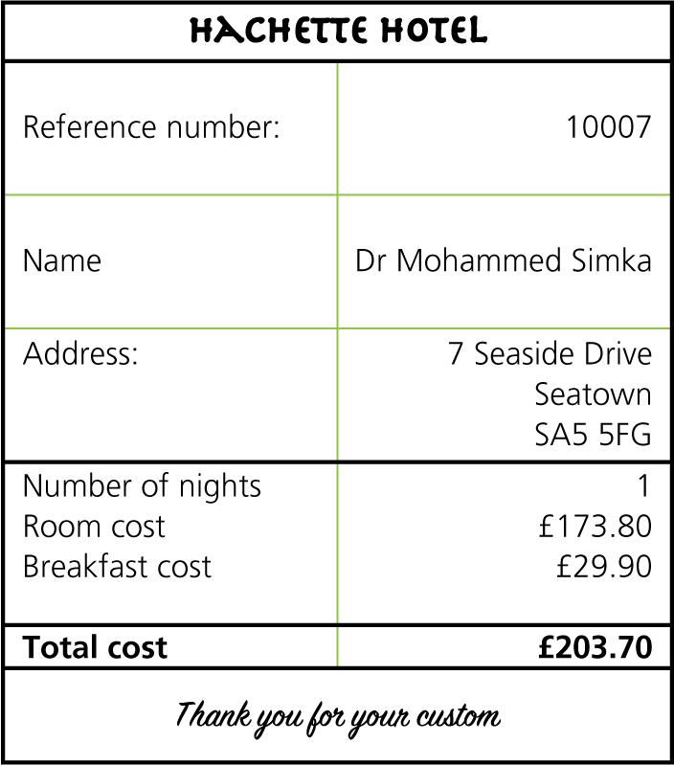
The invoice
When a guest checks out of the hotel, they must be given an invoice. This sets out the goods and services they purchased and tells them how much they need to pay.
The invoice must be easy to read and understand and it must contain:
the name of the hotel
a guest reference number
the name and address of the guest
the number of nights the guest stayed at the hotel
the goods and services purchased by the guest and how much they each cost
the total cost of the stay.

Slide 6
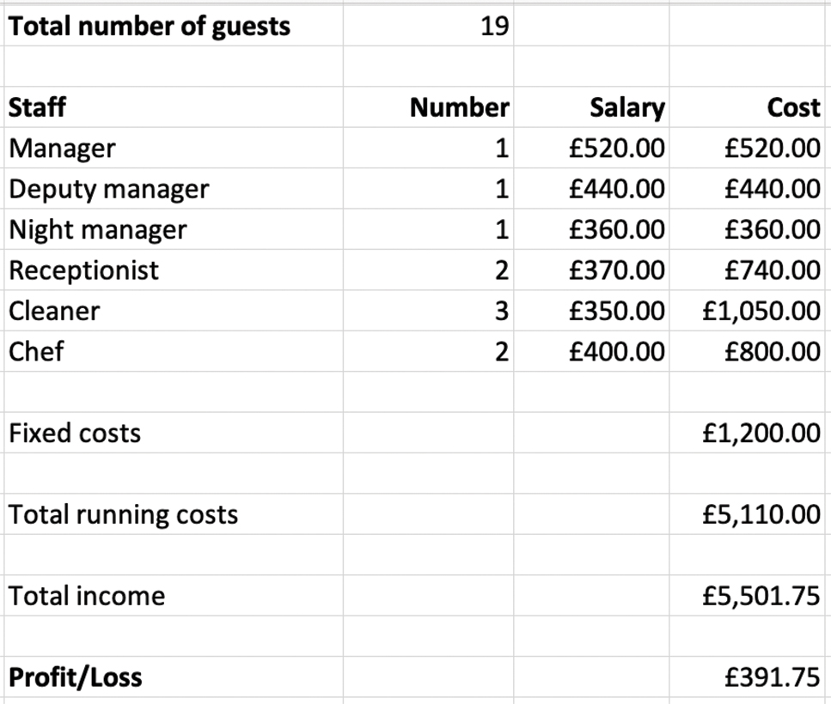
The accounts
All businesses need to keep accounts. These are a record of:
income: the money received from guests
costs: the money spent on paying staff and other fixed costs
profit/loss: the money left over when costs have been paid; this can be a positive sum (profit) or a negative sum (loss).

Slide 7
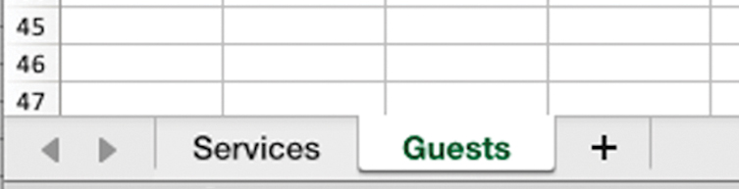
Working with multiple spreadsheets
The finance system you will be building requires you to work with multiple spreadsheets in a workbook.
The spreadsheets can be accessed by clicking on the tabs at the bottom:
To add a new spreadsheet, click on the plus sign. Right click on a tab and select ‘Rename’ to give the new tab an appropriate name.

Slide 8
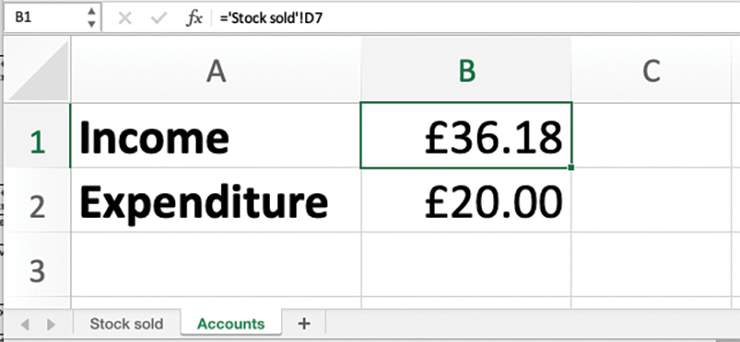
Linking spreadsheets
You can link to data on another spreadsheet in the same workbook.
Select the target cell (the cell in which you would like the data to appear) and type =.
Then select the spreadsheet containing the source data, select the relevant cell and press ‘Enter’.

Slide 9
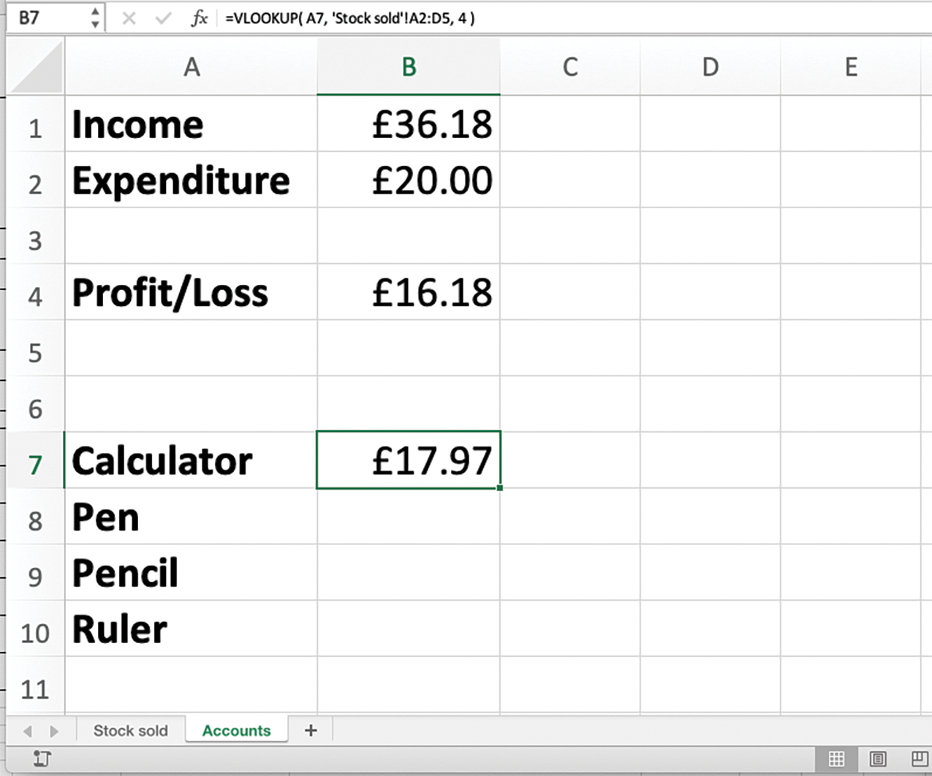
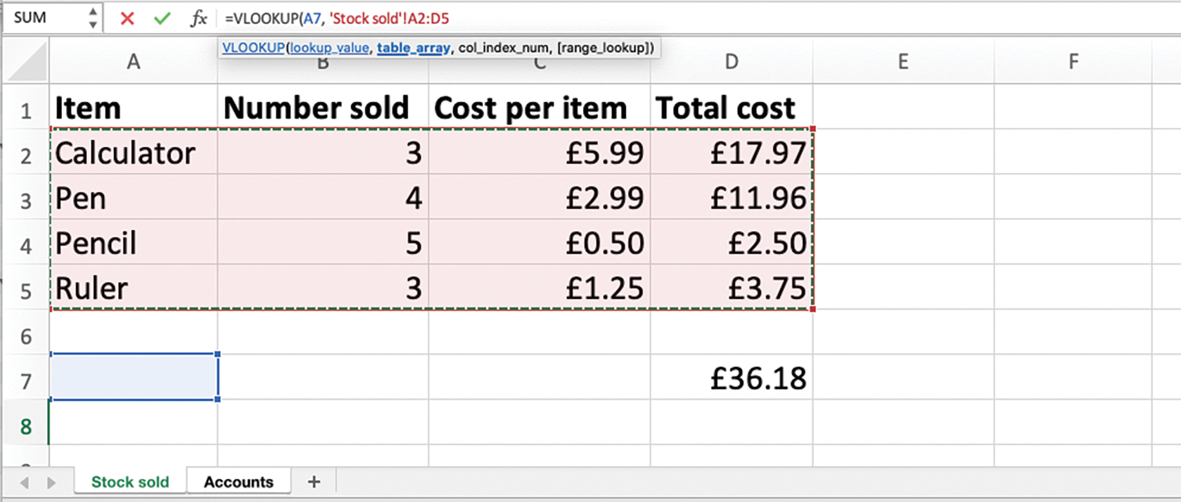
Using the VLOOKUP function with two spreadsheets
You can use a VLOOKUP function to look up values on another spreadsheet in the same workbook.
Select the target cell, type =VLOOKUP( and select the cell containing the look up value. In this example, it is Calculator in cell A7. Type a comma.
Then select the spreadsheet containing the table of values and select the area that contains the data to enter the range. In this example, the range is A2:D5 on the ‘Stock sold’ spreadsheet. Type a comma.
In this example, we want to return the value in the fourth column so we type 4, close the parentheses and press ‘Enter’.
Remember to use absolute cell references for the range if you want to replicate the function.

Slide 10
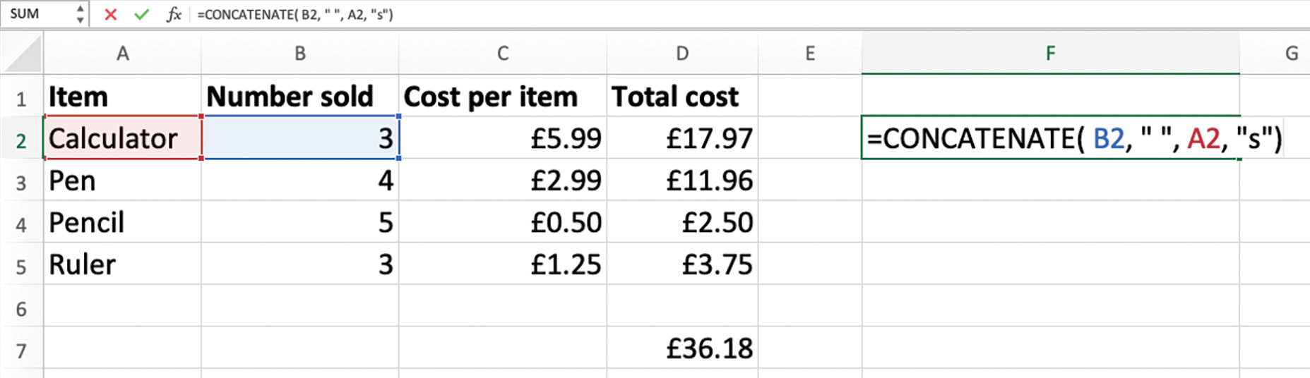
The CONCATENATE function
The CONCATENATE function joins together strings in multiple cells to form one longer string.
In this example, we are joining 3 from cell B2, a space, Calculator from cell A2 and an s to form the string 3 calculators.

Slide 11
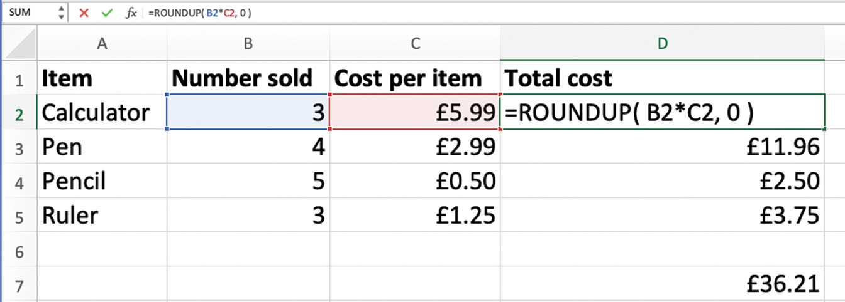
The ROUNDUP functio
The ROUNDUP function is used to round a value up.
In this example, we are rounding the result of B2*C2 to 0 decimal places.
You may need to adjust the cell formatting to ensure that no trailing zeros are displayed. Use the ‘Decrease Decimal’ button to do this.
Watch Video 2.1

Slide 12

Project 2: Finance system

